Slide 1
AMERICAN PSYCHOLOGICAL ASSOCIATION (APA)
STUDENT BRIEFING
2013

Slide 2
AGENDA
INTRODUCTION
WHY WE WRITE IN APA FORMAT
CREATING AN APA TEMPLATE USING MS WORD
APA GUIDELINES

Slide 3
INTRODUCTION
(American Psychological Association (APA) Style is a set of rules that authors use when submitting papers for publications in APA journals. The APA contains guidelines for every aspect of writing, especially in the social sciences, from determining authorship to constructing a table to avoiding plagiarism and constructing accurate reference citations.

Slide 4
WHY WE WRITE IN APA FORMAT
Universities and other educational institutions use APA standards to establish a common writing format. The APA is designed to assist reading comprehension in the social and behavioral sciences, for clarity of communication, and to "move the idea forward with a minimum of distraction and a maximum of precision.

Slide 5
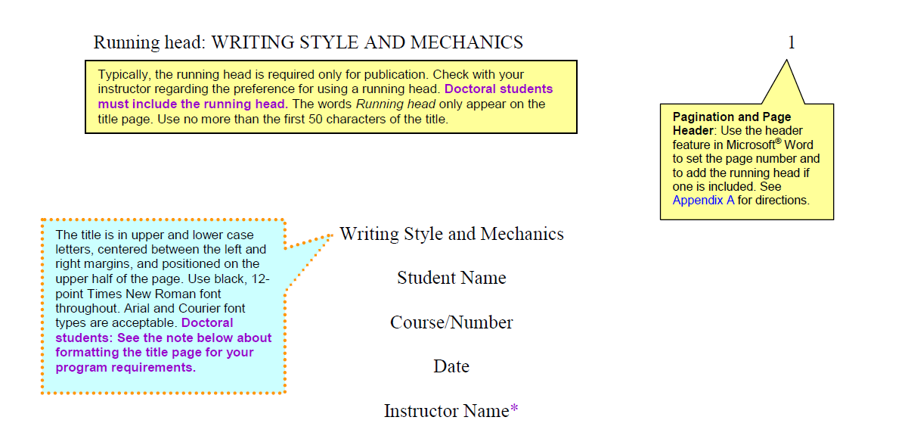
OCU APA GUIDELINES

Slide 6
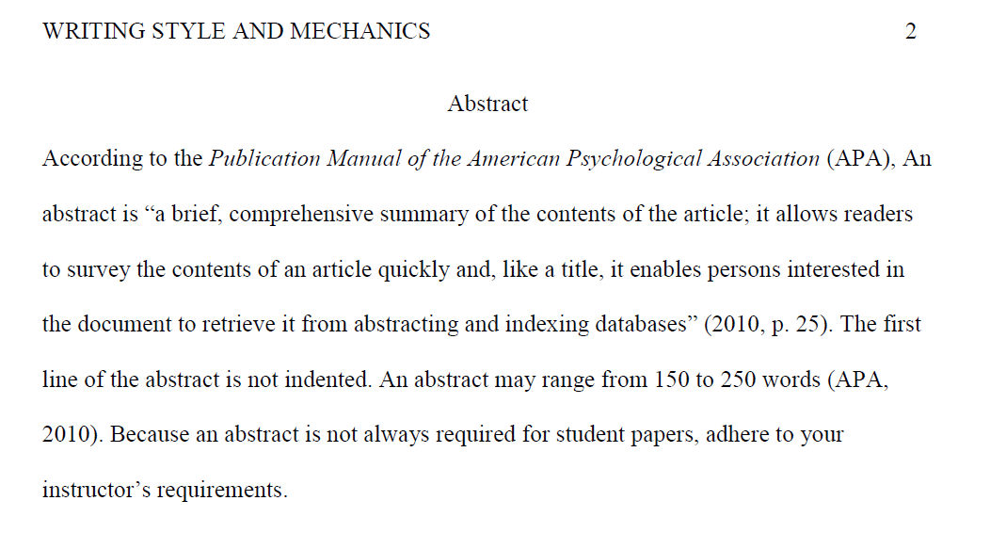

Slide 7
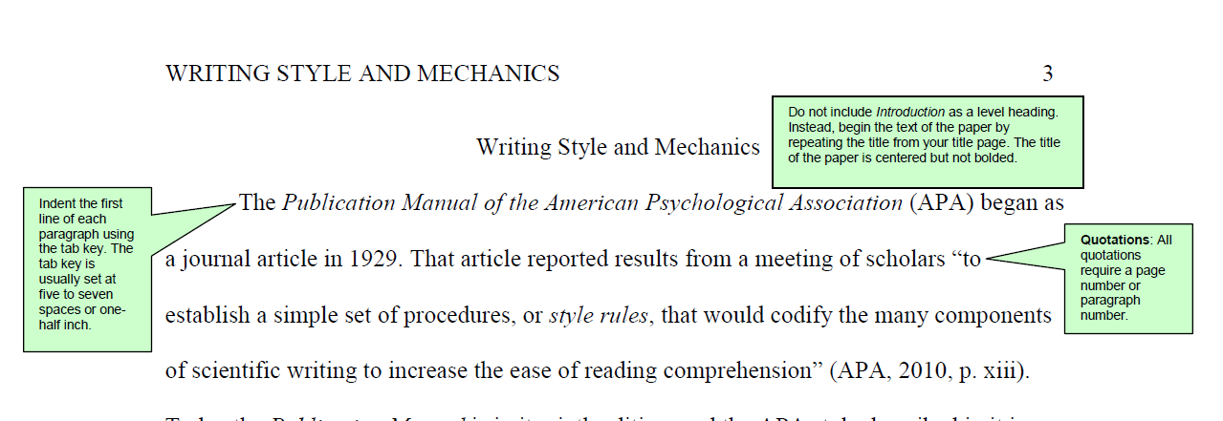

Slide 8
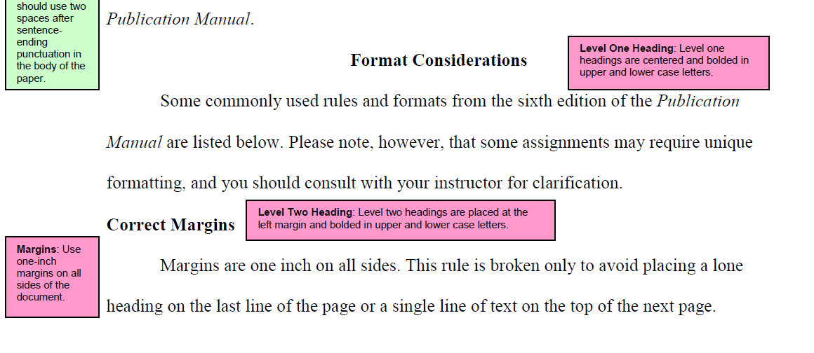

Slide 9
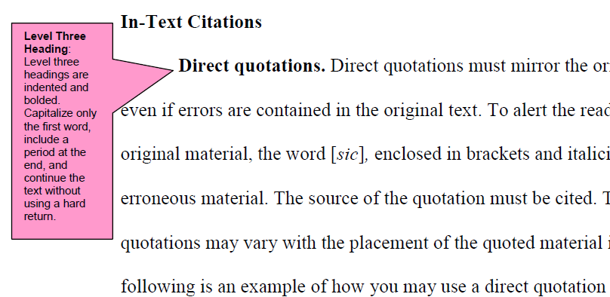

Slide 10
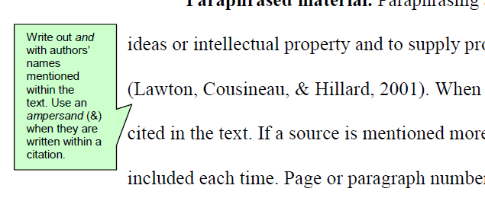

Slide 11
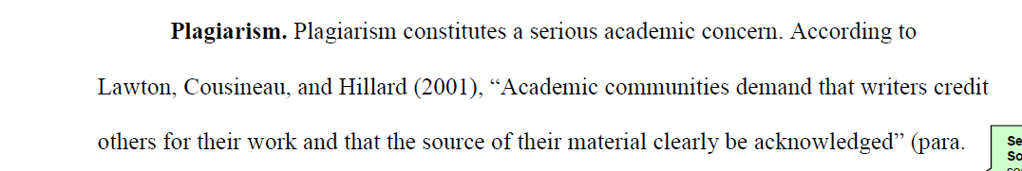

Slide 12
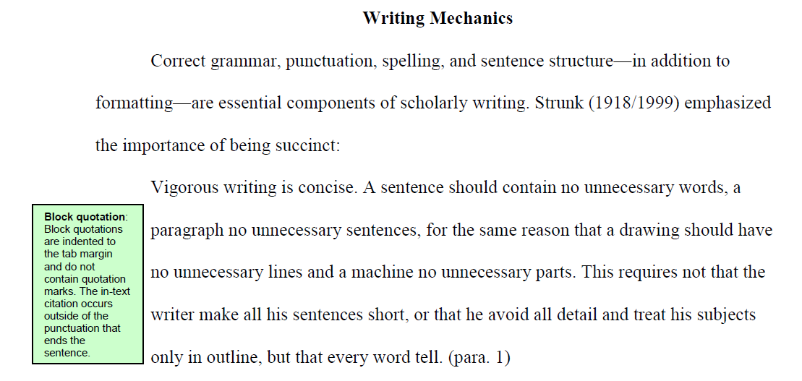
40 palabras o más

Slide 13
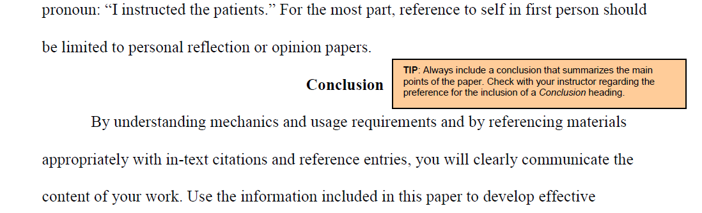

Slide 14
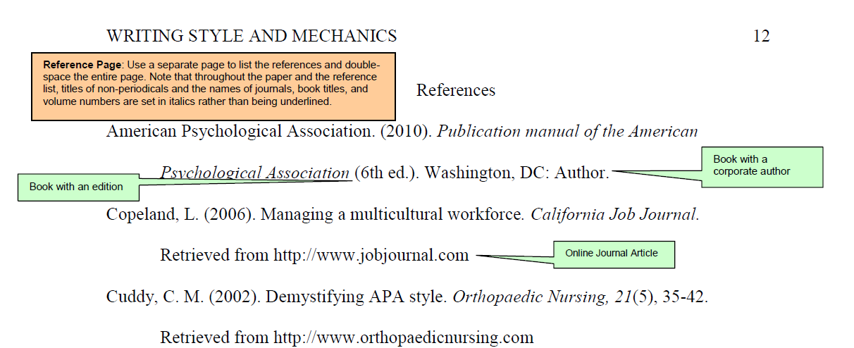

Slide 15
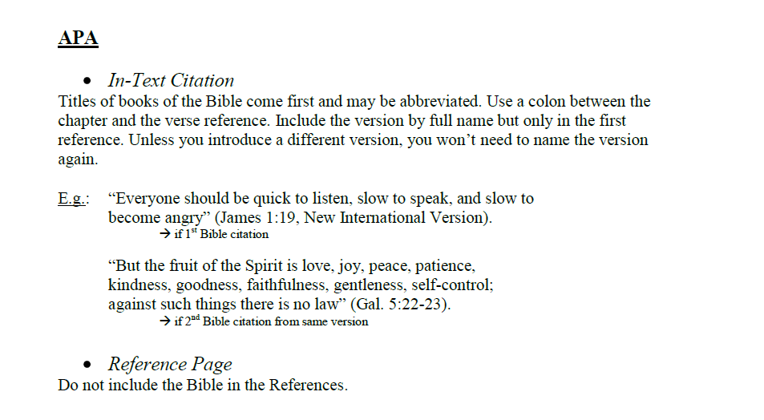

Slide 16
PREGUNTAS ??????

